Slide 1
حقيبة تعليمية
Lectures of
Microbiology
1st Class Nursing
Dr.Hussein Al-Nasrawi

Slide 2
((Microbiology ))
Microbiology :
is the science deal with study of microbes ( bacteria , viruses , fungi and protozoa )
Bacteria :
is a single-celled microorganism, prokaryotic ( no nucleus ) , most are pathogenic and cause diseases .
Classificaton of Bacteria
Classification according to Gram satin:
1- Gram-positive bacteria : cell walls of the gram-positive bacteria are very thick and consists of peptidoglycan .(90%) (stained with blue color)

Slide 3
2- Gram-negative bacteria : cell wall with thin peptidoglycan layer and a thick outer membrane (stained with red color).
Classification according to atmoshere :
1-Aerobic bacteria : require O2 .
2-Anaerobic bacteria : O2 is toxic to this type of bacteria .
3-Facultative anaerobes, growing with and without O2 .
4-Microphiles require reduced O2
5-Capnophiles reuire increased O2

Slide 4
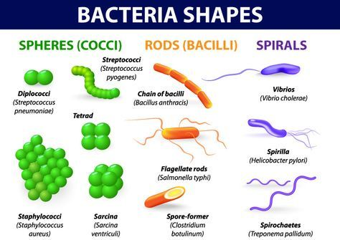
Classification according morphology (Shape) Shapes of bacteria :

Slide 5
Structures of bacteria :
1-Cell wall
2-cytoplasmic membrane
3-Ribosomes
4-Plasmid
5-Chromosome
6-Inclusion body
7-Endospore
External structures
Glycocalyx : Polysaccharides layers for adhesion to liquid surface
Pili :Short , thin hairlike projections , used to adhesion to host tissue and mating .
Fimbriae : like pili but short , use to adhesion to solid liquid surface .
Flagella- Responsible for bacterial movement (motility )

Slide 6
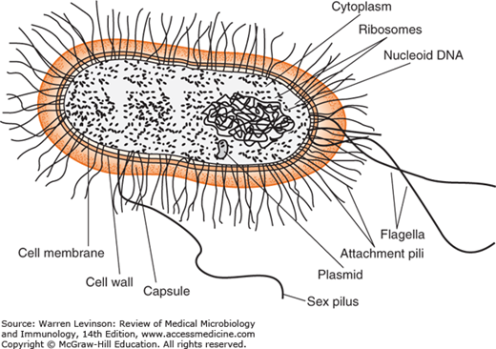
Bacterial cell

Slide 7
((Growth phases of bacteria))
1. Lag phase :
Bacteria takes some time to adjust with the new environment.
2. Exponential or log phase :
Bacteria rapidly growing and dividing
3. Stationary phase :
Rate of growth equal rate of death .
4.Death or Decline phase :
Depletion of nutrients and accumulation of wastes leads to death .

Slide 8
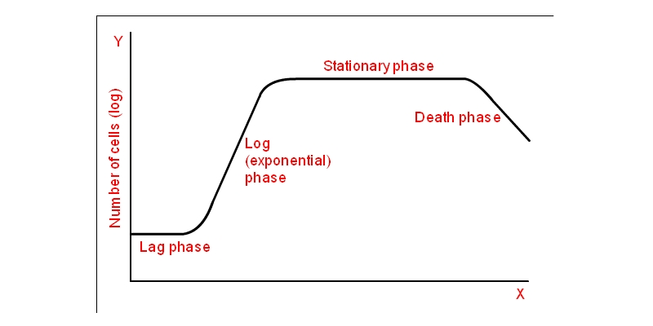
Growth curve of bacteria

Slide 9
Staphylococci
Characteristics :
Gram positive , spherical , in clusters ,Facaltative anaerobes ,Tolarates heat 60C for 30 min.
Clinical significance :
Cutaneous lesions
Folliculitis
Impetigo
Pneumonia
Cystitis Septicemia
Osteomyelitis
Endocarditis
Meningitis

Slide 10
Pathogenic factors of Staphylococcus aureus :
1-Surface antigens a-Capsular polysaccharides
b-Teichoic acid
c-Protein A
d- Adhesions
2-Extracellular proteins :
a-Toxins Alfa , Beta ,Gamma and Delta.
b- Pyrogens (Fever inducers).
MRSA : Methicillin Resistance Staphylococus Aureus :Type of Staphylococcus aureus infection cannot be killed by antibiotics , very common infection in healthy people visit hospitals ,with symptoms of nausea , vomiting and shortness of breath.

Slide 11
(( Streptococci ))
Charcteristics :Spherical , in chains , Gram positive
Classification of streptococci
1-Beta-hemolytic streptococci produce zones of clear hemolysis around each colony, complete haemolysis .ex: S.pyogens .
2-Alpha-hemolytic streptococci incomplete hemolysis.ex: S.viridans.
3-Gamma-hemolytic streptococci are nonhemolytic ex:.S.faeces.

Slide 12
Diseases caused by Streptococci
1- Impetigo
2-Pharyngitis
3-Cellulitis (inflammation of the deeper layers of skin and connective tissue under the skin)
4-Mastitis (inflammation of the breast in women ) .
5-Bacteremia (Spread of bacteria to the bloodstream )
6-Pneumonia
7-Endocarditis ( inflammation of heart valves )
8-Osteomyelitis (Inflammation of the bones )
9-Food poisoning( nausia , vomiting , diarrhea )
10- Streptococcal toxic shock syndrome

Slide 13
GAS: Is a group A Streptococcus that cause diseases by virulence factors : Extracellular enzymes , Mprotein and haemolysins.
Diagnosis of streptococci :
1- By culture (Streptococci are readily identified by culture on a sheep blood agar plate).
2- Sometimes rapid antigen tests or antibody titers
Treatment : Amoxicillin , Ampicillin , Vancomycin , Cephalosporins or macrolides.

Slide 14
Corynebacterium diphtheria .
Characteristics :
Gram positive , rod shape . Special stains like Alberts stain shows metachromatic granules , Lofflers medium is used to preferentially grow C. diphtheriae.
Fleks test use for ability of diphtheria to produce toxin.
Symptoms of diphtheria disease :
1- A thick, gray membrane covering throat and tonsils
2- A sore throat
3- Swollen glands (enlarged lymph nodes) in the neck

Slide 15
4- Difficulty breathing or rapid breathing
5- Nasal discharge
6- Fever and chills
Causes of disease
1- Airborne droplets..
2- Contaminated personal
Risk factors :
1-Children and adults who don't have up-to-date vaccinations
2- People living in crowded areas
3- Anyone who travels to an area where diphtheria infections are more common

Slide 16
Diagnosis :
1- culture of material from the throat membrane
2- take biopsy from the infected skin to check the type of diphtheria of the skin
Treatment:
1- Antibiotics. penicillin or erythromycin.
2- An antitoxin. Antitoxin drug is injected into a vein or muscle.

Slide 17
E.coli ( Escherichia coli)
Characteristics :
Gram positive ,facultative anaerobes , rod shape . E. coli n ormally live in the intestines of people and animals. Some types of E. coli, particularly E. coli O157:H7, can cause intestinal infection and produce Shiga toxin.
Symptoms :
Diarrhea
abdominal pain
fever

Slide 18
abdominal cramping
loss of appetite or nausea
vomiting (uncommon)
fatigue
Treatment :
Most people show improvement within five to seven days after the onset of an infection, and make a full recovery.

Slide 19
Clostridium
Characteristics :
Gram-positive, spore-former bacteria , rod shaped . majority of species are obligate anaerobes; however, some species can grow under aerobic conditions or are aerotolerant.
There are close to 200 species of Clostridium, with only a few species being
pathogenic species:
C. botulinum , C. perfringens , C. sporogenes
C. bifermentans , C. leptum ,C. difficile ,C.tetani

Slide 20
Clostridium botulinum : produce botulin toxin which cause Botulism ( nervous food poisoning ) .
Clostridial bacteremia: caused by C. septicum. .
Clostridial Myonecrosis (Gas Gangrene) caused by Clostridium perfringens .
Clostridium difficile : Clostridium cuse diseas called Antibiotic Aassociated Disease (AAD) .

Slide 21
Pathogenicity of C. difficile
Occurs after use of antibiotic medications.
( Fluoroquinolones , Cephalosporins, Penicillins, Clindamycin). The disease called Antibiotic Associated Disease .
Symptoms :
1-Watery diarrhea 10 to 15 times a day
2-Abdominal cramping and pain
3-Rapid heart rate
4-Fever
5-Blood or pus in the stool
6-Nausea

Slide 22
Bacillus anthracis
Characteristics :
Gram positive , edospore – forming , rod shape .
Types of anthrx diseases :
1-Cutaneous anthrax
2-Gastrointestinal anthrax
3-Inhalation (pulmonary) anthrax
4-Injection anthrax

Slide 23
Symptoms of Cutaneous anthrax
A raised, itchy bump resembling an insect bite that quickly develops into a painless sore with a black center.
Swelling in the sore and nearby lymph glands
Symptoms of Gastrointestinal anthrax
Nausea
Vomiting
Abdominal pain
Headache
Loss of appetite
Fever
Severe, bloody diarrhea in the later stages of the disease
Sore throat and difficulty swallowing
Swollen neck

Slide 24
Symptoms of Inhalation (pulmonary) anthrax
Flu-like symptoms, such as sore throat, mild fever, fatigue and muscle aches.
Mild chest discomfort
Shortness of breath
Nausea
Painful swallowing
High fever
Trouble breathing
Shock
Meningitis — a potentially life-threatening inflammation of the brain and spinal cord

Slide 25
Injection anthrax
(This is the most recently identified route of anthrax infection. It's contracted through injecting illegal drugs and has been reported only in Europe so far).
Symptoms of injection anthrax :
Redness at the area of injection
Significant swelling
Multiple organ failure
Meningitis

Slide 26
Diagnosis of anthrax :
Skin testing. A sample of fluid from a suspicious lesion on your skin or a small tissue sample (biopsy) may be tested in a lab for signs of cutaneous anthrax.
Blood tests. You may have a small amount of blood drawn that's checked in a lab for anthrax bacteria.
Chest X-ray or computerized tomography (CT) scan. to help diagnose inhalation anthrax.
.

Slide 27
Stool testing :
check a sample of your stool for anthrax bacteria.
Spinal tap (lumbar puncture). :
In this test, doctor inserts a needle into your spinal canal and withdraws a small amount of fluid. A spinal tap is usually done only to confirm a diagnosis of anthrax meningitis.
Treatment of anthracx :
The standard treatment for anthrax is a 60-day course of an antibiotic, such as ciprofloxacin (Cipro) or doxycycline (Monodox, Vibramycin, others).
Anthrax vaccine :
For humans is available. The vaccine isn't intended for the general public.

Slide 28
Mycobacterium tuberculosis
Characteristics :
1-Curved rod .
2-Bacteria in host tissue produce granules with horseshoe nuclei. .
3-Highly aerobic ( require increased O2) .
4- This bacteria ha waxy coating (with mycolic acid , not absorb the gram stain) make the cells impervious to gram stain which can appear either gram negative or gram positive , So the suitable stain is Acid fast stain such as Ziehl-Neelsen stain .

Slide 29
Specific culture media : Lowensten –Jensen medium .
Pathogenicity :
M.tuberculosis bacteria can transmitted from person to another by coughing , sneezing ,speaking , kissing or contacting patients objects or kissing.
When the bacteria invade the lungs , macrophage cells unable to kill and digest it.

Slide 30
Symptoms :
Coughing for more than 3 weeks
Chest pain.
Weight loss .
Fever.
Night sweet.
Chills.
Lost of appetite
When kidney affected, leads to blood in urine .

Slide 31
Treatment of Tb :
4- drug regimen for 12 months :
1-Isoniazid
2-Rifampin
3-Pyrazinamide
4-Either Ethambutol or Streptomycin.

Slide 32
Vibrio cholerae
Characteristics :
Gram negative , comma shaped, slightly curved, with a flagellum at one cell pole as well as pili. The Vibrios tolerate alkaline media that kill most intestinal commensals , but they are sensitive to acid.Facultative anaerobes . Produce cholera toxin .
Symptoms :
Watery diarrhea .
Vomiting
wrinkled skin.
Low blood pressure

Slide 33
- Dry mouth
- Rapid breath rate
-Death .
Treatment
1- Fluid and electrolyte replacement, both oral and IV.
2-Antibiotics usually are used in severe infections:
Tetracycline ,Doxycycline ,Furazolidone ,Erythromycin and Azithromycin .

Slide 34
Parasitology
Parasitology : Is the science deal with parasites .
Entamoeba histolytica : Causes amoebiasis disease ( Dysentery).
Pathogenicity : The cysts of the parasite transmit with polluted food and pass into the intestine to cause dysentery disease .
Symptoms :
1- Bloody diarrhea
2- Stool with Mucous and abscess
3-Potencially cause amoebic liver abscess.

Slide 35
Giardia lamblia
Cause Giardiasis disease infection of the small intestine (cause of parasitic gastrointestinal disease).
Giardia lamblia two forms, an active form called a trophozoite, and an inactive form called a Cyst . The active trophozoite attaches to the lining of the small intestine with a "sucker" and giardiasis.
The inactive cyst , when ingested, stomach acid activates the cyst, and the cyst develops into the disease-causing trophozoite.

Slide 36
Symptoms
1-diarrhea,
2- gas,
3- fatty or foul-smelling stools
4- Abdominal cramping
Diagnoses:
Antigen testing of the stool .
Treatment :
Metronidazole ( Flagyl) for 5-10 days.

Slide 37
Toxoplasma gondii
Causes Toxoplasmosis disease , the parasite found in cat feces.
Symptoms: 1- fever 2- swollen lymph nodes 3-headach 4- muscle and chest pain 5- sore throat .
Diagnosis : By serology or by dectecting of T.gondii DNA by using PCR .
Treatment : a combination of drugs such as pyrimethamine and sulfadiazine, plus folinic acid.

Slide 38
leishmania
Leishmania tropica : Cause Baghdad boil disease (cutaneous leishmaniasis) .
Symptoms :
1- Nodules or sores on the skin(including face skin ) .
2- Affected people may have a single lesion or many lesions.
3- Sores heal slowly over months to years and leave scars .
Leishmania donovani : Also called kala-azar .
Symptoms :
1- Enteric fever
2- Infection of liver , spleen, and bone marrow.
Treatment : Yomesan drug .

Slide 39
Virology
Virology : Is the science deal with study of viruses.
Virus: a small microorganism composed of Protein cover (Capsid) and Nucleic acid (DNA or RNA).
فايروسات الحلأ Herpes viruses :
Viruses infect humans include herpes simplex virus , 1 and 2 , Varicella –Zoster virus ,Cytomeglovirus
Properties of Herpes viruses :
Double strand DNA virus
Icosahedral Symmetry protein coat
Capsid with 162 capsomers
Contain envelope with 8 spikes
Herpes simplex virus : فايروس الحلأ
There are two types of Herpes simplex virus 1 and 2 , HSV1 produce most cold sores , and HSV2 cause most genital herpes.

Slide 40
Hepatitis viruses
Hepatitis A virus cause viral hepatitis . HBV and HCV are known to cause long term infections that increase chances of liver cancer. Both are spread through unprotected sex, sharing needles of childbirth.
Symptoms :
1- Hepatitis B virus, is known to cause flu like symptoms and jaundice, or yellowing of the eyes and skin.
2-HCV leads to liver cancer.
Note : Most people with HBV infection recover completely and are not chronic carriers of the virus.

Slide 41
Rubella virus ( German measles)
Rubella ( German measles , 3 days measles )
is an acute febrile illness characterized by a rash and lymphadenopathy that affects children and young adults . The infection during early pregnancy may result in serious abnormalities of the fetus .متعلق بالحمى
1- Postnatal Rubella :
بعد الولادة
Neonatal , childhood and adult infections occur through the mucosa of the upper respiratory tract . viral replication probably occur in the respiratory tract الغدد اللمفاوية العنقية, followed by multiplication in the cervical lymph nodes.
Diagnosis: Nasopharengeal or throat swabs taken 6 days before and after onset of rash are a good source

Slide 42
Mumps Virus
Mumps is a common acute disease of children and young adults that is characterized by inflammation of the salivary glands, especially the parotids.Mumps. virus infections usually induce lifelong immunity.
Symptoms
1-swelling of parotid glands
2-Swelling usually lasts for 10 days with fever, Ear-ache, difficulty to talk, eat, open the mouth for 1-6 days.
3-Affects various organs like salivary glands - Parotid glands, kidneys, testicles (Males), ovaries (females), pancreas, breast and joints

Slide 43
Orthomyxoviruses
Influenza viruses :
Are three types A , B and C , RNA viruses belonging to the orthomyxo viruses .
Influenza virus Composed of 2 glycoproteins :
1- Hemagglutinin (HA) 2- Neuraminidase (NA) .
There are 16 hemagglutinins (H1 to H16) and 9 neuraminidases H1N1, Swine Flu , H5N1, Bird Flu (avian) .
Influenzavirus B : exclusively infects humans. and is less common than influenza A.
Influenzavirus C : Infects humans , dogs and pigs, less common than the other types

Slide 44
:Symptoms of influenza A:
1-Chills or a chilly sensation
2- Fever is also common (38 to 39 °C )
3- Cough and aches
4- Runny nose , Sneezing
5-Body aches, especially joints and throat .
6- Headache , Reddened eyes, skin ,mouth, throat and nose.

Slide 45
Cytomegalovirus (CMV ) :فايروس تضخم الخلايا
Rarely cause problems in healthy people.
Risk factors ;
New born , infants , babies through breast milk .
People with weakened immune system
Symptoms:
Yellow skin
Hearing lost
Enlargement of spleen
Pneumonia

Slide 46
Varcilla Zoster Virus (VZV)فايروس جدري الماء النطاقي
This virus infects children causing chicken pox .
Risk factors:
Commonly affecting children .
In Infants cause Chicken pox .
In Adults cause Zoster .
Symptoms:
1-Pneumonia
2-Brain inflammation.

Slide 47
HIV Virus
The human immunodeficiency virus (HIV) cause immunodeficiency syndrome disease (AIDS). The HIV virus enters macrophages and CD4+ T cells and release of the HIV capsid into the cell. Spread within the body
HIV is now known to spread between CD4+ T cells by two parallel routes: cell-free spread and cell-to-cell spread, i.e. it employs hybrid spreading mechanisms.
Symptoms: The infected person objected easily to infections due to weakened immunity system.

Slide 48
Diagnosis
Test blood compsition of HIV copies (viral load) and CD4 counts.
Medications
No cure for (AIDS), but medications have been highly effective in fighting HIV such as :
Abacavir (Ziagen, ABC)
Didanosine (Videx, dideoxyinosine, ddI)
Emtricitabine (Emtriva, FTC)

Slide 49
(( Types of Mycoses ))
Mycoses : are human fungal infections .
Types of Mycoses
1- Superficial mycoses
Infections limited to the outermost layers of the skin and hair. The superficial mycoses are: Pityriasis versicolor , Tinea nigra , Black and White piedra .
2- Cutaneous mycoses
Infections that extend deeper into the epidermis, as well as invasive hair and nail diseases.These diseases are restricted to the keratinized layers of the skin, hair and nailsne.

Slide 50
(( Types of Mycoses ))
3- Subcutaneous mycoses
Infections involving the dermis, subcutaneous tissues, muscle and fascia.These infections initially involve the deeper layers of the dermis, subcutaneous tissue or bone.
4- Primary systemic mycoses (Endemic mycoses)) Primary systemic ( dimorphic ) mycoses ,caused by fungi that can cause systemic infection in people with normal immune function as well as those who are immune compromised.
5- Opportunistic mycoses ( Opportonistic systemic mycoses )
Fungi that only result in systemic infection in immuno-compromised or sick people.

Slide 51
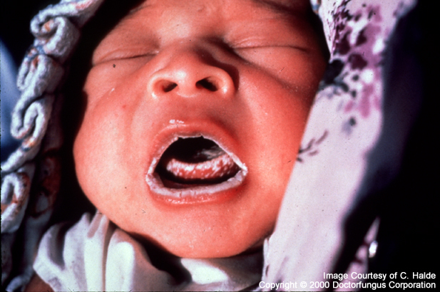
Candidiasis Candidiasis is mycotic infection caused by members of the genus Candida. localized to the mouth, throat, skin, scalp, vagina, fingers, nails, bronchi, lungs, or the gastrointestinal tract, or become systemic as in septicemia, endocarditis and meningitis. Treatment : Nystatine .

